Slide 1




University Institute of Engineering
Department of Computer Science & Engineering
COMPUTER ORGANIZATION & ARCHITECTURE
(23CST-204/23ITT-204)
ER. SHIKHA ATWAL
E11186
ASSISTANT PROFESSOR
BE-CSE

Slide 2
AMDAHL'S LAW
In parallel computing, Amdahl's law is mainly used to predict the theoretical maximum speed up for program processing using multiple processors.
It is named after computer scientist Gene Amdahl (a computer architect from IBM and Amdahl corporation), and was presented at the AFIPS Spring Joint Computer Conference in 1967.
It is also known as Amdahl’s argument.
It is a formula which gives the theoretical speedup in latency of the execution of a task at a fixed workload that can be expected of a system whose resources are improved.
In other words, it is a formula used to find the maximum improvement possible by just improving a particular part of a system. It is often used in parallel computing to predict the theoretical speedup when using multiple processors.

Slide 3
Speedup
Speedup is defined as the ratio of performance for the entire task using the enhancement and performance for the entire task without using the enhancement or speedup can be defined as the ratio of execution time for the entire task without using the enhancement and execution time for the entire task using the enhancement.
If Pe is the performance for entire task using the enhancement, when possible, Pw is the performance for entire task without using the enhancement, Ew is the execution time for entire task without using the enhancement and Ee is the execution time for entire task using the enhancement when possible then,
Speedup = Pe/Pw
or
Speedup = Ew/Ee

Slide 4
Amdahl’s law uses two factors to find speedup from some enhancement.
Fraction enhanced – The fraction of the computation time in the original computer that can be converted to take advantage of the enhancement.
For example- if 10 seconds of the execution time of a program that takes 40 seconds in total can use an enhancement, the fraction is 10/40. This obtained value is Fraction Enhanced.
Fraction enhanced is always less than 1.
Speedup enhanced – The improvement gained by the enhanced execution mode; that is, how much faster the task would run if the enhanced mode were used for the entire program.
For example – If the enhanced mode takes, say 3 seconds for a portion of the program, while it is 6 seconds in the original mode, the improvement is 6/3. This value is Speedup enhanced. Speedup Enhanced is always greater than 1.

Slide 5
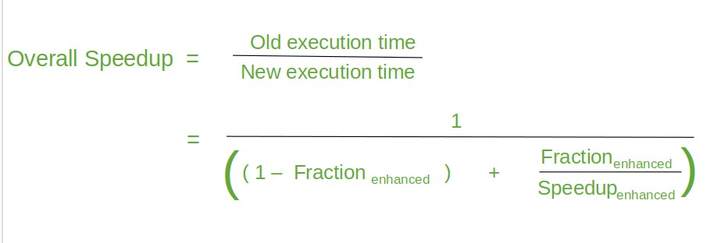
The overall Speedup is the ratio of the execution time.

Slide 6

Proof:
When a program is run on a parallel computer then the computation may be serial, parallel or both. At times, there will be a certain part of the program which has to run serially. This part is termed to be a sequential fraction of computing.
Consider the sequential fraction of the program to be F. Then the parallel computation of the program will be 1-F. Based on this, Amdahl's law states that the speedup of parallel computer is given by the relation below.
where 'p' is the number of processors.

Slide 7


To prove the above relation, let us take an example of execution of a task on a computer with a single processor and p number of processors. We already know that the speedup is given by the relation,
Consider that the execution time required to complete the given task on a computer with single processor is T. When the same task is executed on parallel computer with p processors, then the time required will depend upon sequential computing time and parallel computing time that is,
T(p) = Sequential computing Time + Parallel Computing Time
where 'p' is the number of processors.

Slide 8


Therefore, by equation 1
From equation (2), we can say that S(p) will always be ≤ 1, that is

Slide 9
Example: Suppose, Moni have to attend an invitation. Moni’s another two friend Diya and Hena are also invited. There are conditions that all three friends have to go there separately and all of them have to be present at door to get into the hall. Now Moni is coming by car, Diya by bus and Hena is coming by foot. Now, how fast Moni and Diya can reach there it doesn’t matter, they have to wait for Hena. So, to speed up the overall process, we need to concentrate on the performance of Hena other than Moni or Diya.
This is actually happening in Amdahl’s Law. It relates the improvement of the system’s performance with the parts that didn’t perform well, like we need to take care of the performance of those parts of the systems. This law often used in parallel computing to predict the theoretical speedup when using multiple processors.

Slide 10
Formula for max. Speedup
Amdahl’s Law can be expressed in mathematically as follows −
SpeedupMAX = 1/((1-p)+(p/s))
where,
SpeedupMAX = maximum performance gain
s = performance gain factor of p after implement the enhancements. p = the part which performance needs to be improved.
Example 1: Let’s take an example, if the part that can be improved is 30% of the overall system and its performance can be doubled for a system, then −
SpeedupMAX = 1/((1-0.30)+(0.30/2))= 1.18

Slide 11
Example 2: Now, in another example, if the part that can be improved is 70% of the overall system and its performance can be doubled for a system, then −
SpeedupMAX= 1/((1-0.70)+(0.70/2)) = 1.54
So, we can see, if 1-p can’t be improved, the overall performance of the system cannot be improved so much. So, if 1-p is 1/2, then speed cannot go beyond that, no matter how many processors are used.
Multicore programming is most commonly used in signal processing and plant-control systems. In signal processing, one can have a concurrent system that processes multiple frames in parallel. the controller and the plant can execute as two separate tasks, in plant-control systems.
Multicore programming helps to split the system into multiple parallel tasks, which run simultaneously, speeding up the overall execution time.

Slide 12
References
Reference Books:
J.P. Hayes, “Computer Architecture and Organization”, Third Edition.
Mano, M., “Computer System Architecture”, Third Edition, Prentice Hall.
Stallings, W., “Computer Organization and Architecture”, Eighth Edition, Pearson Education.
Text Books:
Carpinelli J.D,” Computer systems organization &Architecture”, Fourth Edition, Addison Wesley.
Patterson and Hennessy, “Computer Architecture”, Fifth Edition Morgaon Kauffman.

Slide 13
Other References:
https://www.tutorialspoint.com/what-is-amdahl-s-law
https://www.techopedia.com/definition/17035/amdahls-law
https://www.geeksforgeeks.org/computer-organization-amdahls-law-and-its-proof/
Video Links:
https://youtu.be/2dYV_lADfFI?si=DNu3JcYHY23ZDJK7
https://youtu.be/DpMVYR8FauE?si=14MZ4ffnCh4kG6VO

